Slide 1
Business Intelligence Concepts, Tools, and Applications
Week 1: Decision Making and Decision Support Systems
Lesson 3: Decision Support Systems

Slide 2
Decision Support Systems
Learning Objectives
Define a decision support system (DSS) and list its main components
Summarize DSS types and classifications, and explain how DSS have changed over time.

Slide 3
Decision Support Systems (DSS)
DSS describes any computerized system that supports decision making in an organization.
DSS is to support managerial decisions in semi-structured and unstructured decision situations that middle-level managers typically face;
attempt to combine the use of models or analytical techniques with traditional data access and retrieval functions;
focus on features which make them easy to use in an interactive mode;
emphasize flexibility and adaptability to accommodate changes in the environment and decision-making approach of the user.
Notes:
From SHARDA, RAMESH; DELEN, DURSUN; TURBAN, EFRAIM, BUSINESS INTELLIGENCE AND ANALYTICS: SYSTEMS FOR DECISION SUPPORT, 10th Edition, © 2015. Used by permission of Pearson Education, Inc., New York, NY. All Rights Reserved.

Slide 4
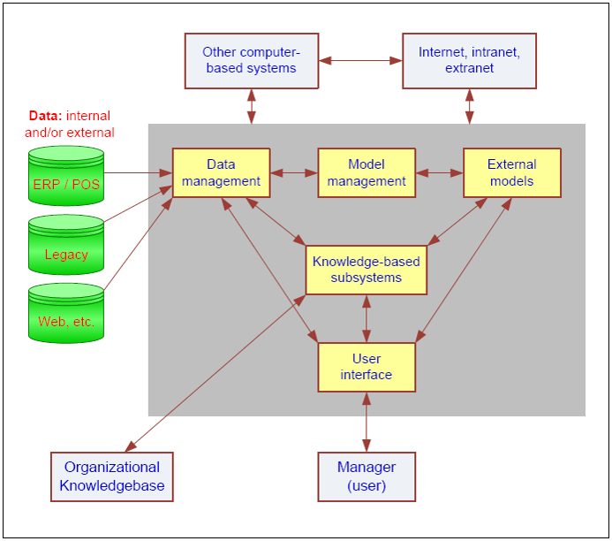
Components of DSS
From SHARDA, RAMESH; DELEN, DURSUN; TURBAN, EFRAIM, BUSINESS INTELLIGENCE AND ANALYTICS: SYSTEMS FOR DECISION SUPPORT, 10th Edition, © 2015. Used by permission of Pearson Education, Inc., New York, NY. All Rights Reserved.
Notes:
From SHARDA, RAMESH; DELEN, DURSUN; TURBAN, EFRAIM, BUSINESS INTELLIGENCE AND ANALYTICS: SYSTEMS FOR DECISION SUPPORT, 10th Edition, © 2015. Used by permission of Pearson Education, Inc., New York, NY. All Rights Reserved.

Slide 5
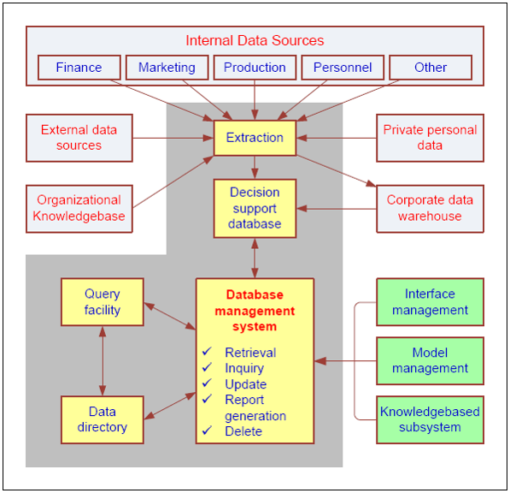
Data Management Subsystem
From SHARDA, RAMESH; DELEN, DURSUN; TURBAN, EFRAIM, BUSINESS INTELLIGENCE AND ANALYTICS: SYSTEMS FOR DECISION SUPPORT, 10th Edition, © 2015. Used by permission of Pearson Education, Inc., New York, NY. All Rights Reserved.
Notes:
From SHARDA, RAMESH; DELEN, DURSUN; TURBAN, EFRAIM, BUSINESS INTELLIGENCE AND ANALYTICS: SYSTEMS FOR DECISION SUPPORT, 10th Edition, © 2015. Used by permission of Pearson Education, Inc., New York, NY. All Rights Reserved.

Slide 6
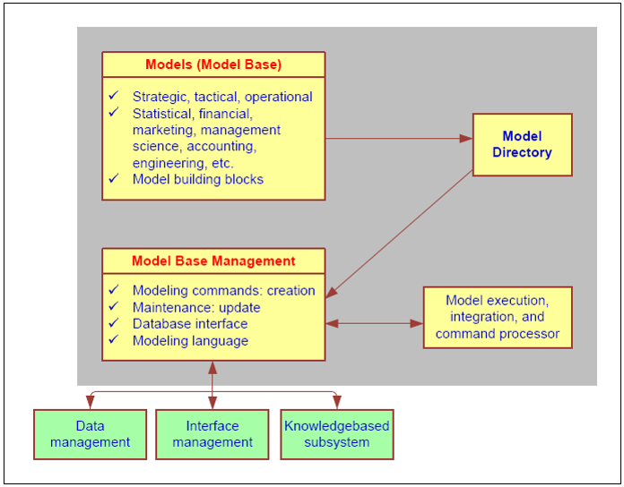
Model Management Subsystem
From SHARDA, RAMESH; DELEN, DURSUN; TURBAN, EFRAIM, BUSINESS INTELLIGENCE AND ANALYTICS: SYSTEMS FOR DECISION SUPPORT, 10th Edition, © 2015. Used by permission of Pearson Education, Inc., New York, NY. All Rights Reserved.
Notes:
From SHARDA, RAMESH; DELEN, DURSUN; TURBAN, EFRAIM, BUSINESS INTELLIGENCE AND ANALYTICS: SYSTEMS FOR DECISION SUPPORT, 10th Edition, © 2015. Used by permission of Pearson Education, Inc., New York, NY. All Rights Reserved.

Slide 7
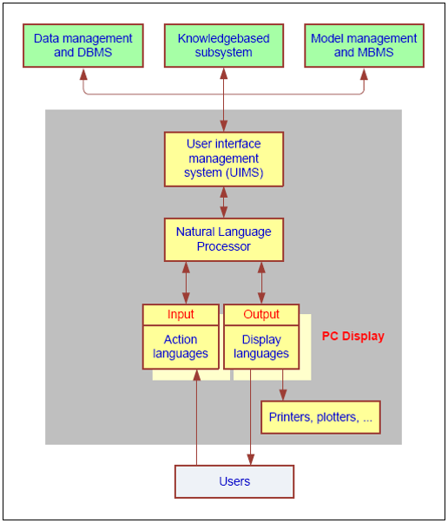
User Interface Subsystem
From SHARDA, RAMESH; DELEN, DURSUN; TURBAN, EFRAIM, BUSINESS INTELLIGENCE AND ANALYTICS: SYSTEMS FOR DECISION SUPPORT, 10th Edition, © 2015. Used by permission of Pearson Education, Inc., New York, NY. All Rights Reserved.
Notes:
From SHARDA, RAMESH; DELEN, DURSUN; TURBAN, EFRAIM, BUSINESS INTELLIGENCE AND ANALYTICS: SYSTEMS FOR DECISION SUPPORT, 10th Edition, © 2015. Used by permission of Pearson Education, Inc., New York, NY. All Rights Reserved.

Slide 8
DSS Classifications
Data-driven
Document-driven
Knowledge-driven
Model-driven
Communications driven
Source: Dan Power is the founder of DSS Resources (www.DSSResouces.com),
Notes:
Dan Power is the founder of DSS Resources (www.DSSResouces.com), a comprehensive website devoted to decision support. On his website, Power provides a contemporary classification system for DSS.

Slide 9
Evolution of DSS Applications
Executive Information Systems (EIS)
Group Support Systems (GSS)
Geographic Information Systems (GIS)
Expert Systems (ES)
Knowledge Management Systems (KMS)
Enterprise Resource Planning Systems (ERP), Customer Relationship Management Systems (CRM), Supply Chain Management Systems (SCM)
From SHARDA, RAMESH; DELEN, DURSUN; TURBAN, EFRAIM, BUSINESS INTELLIGENCE AND ANALYTICS: SYSTEMS FOR DECISION SUPPORT, 10th Edition, © 2015. Used by permission of Pearson Education, Inc., New York, NY. All Rights Reserved.
.
Notes:
From SHARDA, RAMESH; DELEN, DURSUN; TURBAN, EFRAIM, BUSINESS INTELLIGENCE AND ANALYTICS: SYSTEMS FOR DECISION SUPPORT, 10th Edition, © 2015. Used by permission of Pearson Education, Inc., New York, NY. All Rights Reserved.

